Slide 1
Umbrella Organisations for Civil Society Organisations(CSOs)/ Non-Profit Organisations (NPOs)
‘NPO Level Up Training: Introduction session’
Theme: ‘Equipping Non-Profits to Achieve Higher Levels of Efficiency, ensuring Sustainability’
Date: Monday, 23 September 2024
Time: 08:30 for 09:00am – 12:00pm
Place: House of Democracy, 70-72 Dr Frans Indongo Street, Windhoek

Slide 2
WHO WE ARE
Our founding document, the Constitution of the Civil Society Information Centre, which established CIVIC +264 as a voluntary association, was signed in 2019.
The organisation is governed by a Board of Directors and managed by a Director, Mrs Melanie Markus, with the support of a Communications Officer, Bradley Tjongarero.
Board of Directors:
Chairperson: Graham Hopwood (IPPR – Institute for Public Policy Research),
Naita Hishoono (NID – Namibia Institute for Democracy)
Toni Hancox (LAC – Legal Assistance Centre)
Zoe Titus (NMT – Namibia Media Trust)

Slide 3
A NEED AROSE
The five founding organisations (NID, LAC, IPPR, NMT & CATS - Citizens for an Accountable and Transparent Society) of CIVIC +264 agreed that such an information service would advance the effectiveness of civil society in Namibia.
Thus CIVIC +264 was established in 2019 with the aim to facilitate the circulation of information in the civil society community and an initial database of civil society organisations was compiled, which is continuously updated and extended.
CIVIC +264 as well as its website were launched on 10 November 2020.

Slide 4
Definition of CSOs
There are many overlapping terms that people use to describe civil society organisations (CSOs). Note that none of these are legal terms in Namibia, and none of them have precise definitions.
CSOs are non-profit groups formed voluntarily by citizens to advance shared goals or interests.
Non-governmental organisations (NGOs) are non-profit groups that function independently of government.
CSOs are generally non-profit organisations (NPOs).
Community-based organisations (CBOs) are typically civil society organisations that work in a single local community.
Faith-based organisations (FBOs) are CBOs that are affiliated with a religious group or inspired by religious or spiritual beliefs.
An umbrella body is just one of many terms for groups that bring together CSOs (and sometimes other stakeholders as well).

Slide 5
Understanding Umbrella Organisations
What Are Umbrella Organisations?
Umbrella organisations are associations or coalitions of CSOs/NPOs that work together to achieve shared goals.
They often provide support and representation for their member organisations. These organisations serve as a collective voice, enabling smaller organisations to gain greater visibility and impact.
Types of Umbrella Organisations:
Sector-Specific - Grouping organisations within the same field (e.g health, education, environment) e.g Namibia Chamber of Environment
Multi-Sectoral - Bringing together organisations from different sectors with a common purpose e.g. The Namibia NGO Forum Trust, NamNet
Regional or National Networks - Supporting organisations within a specific geographic area e.g. Hardap Civil Society Organisations Network

Slide 6
Umbrella Organisations listed on the CIVIC +264 website (1/3): www.civic264.org.na

Slide 7
Umbrella Organisations listed on the CIVIC +264 website (2/3): www.civic264.org.na

Slide 8
Umbrella Organisations listed on the CIVIC +264 website (3/3): www.civic264.org.na

Slide 9
Eligibility criteria for self-listing on the CIVIC +264 website
Active civil society organisations (CSOs).
Online presence (web/social media/search engines) showing activity.

Slide 10
Benefits of Umbrella Organisations to CSOs/NPOs
Advocacy and Representation
Stronger Voice & Policy Influence
Capacity Building and Support
Training and Development & Best Practices/Knowledge Sharing
Resource Mobilisation
Funding Opportunities & Partnership
Networking and Collaboration
Building Relationships & Cross-Sector Collaboration
Operational Efficiency and Guidance
Administrative and Legal Support & Direction

Slide 11
How CIVIC +264 Adds Value
Support and Services Provided by CIVIC +264
CIVIC +264 offers a range of support services to CSOs in Namibia, including training, information sharing and networking opportunities.
Our online directory connects CSOs with potential partners and donors.
We offer resources to help organisations strengthen their internal structures and ensure compliance with national regulations.
Promoting Unity and Cooperation
CIVIC +264 connects, collaborates and communicates with all CSOs ( incl. umbrella organisations) to create a more cohesive civil society sector.
We encourage cooperation between organisations, believing that by working together, CSOs can increase their impact and sustainability.

Slide 12
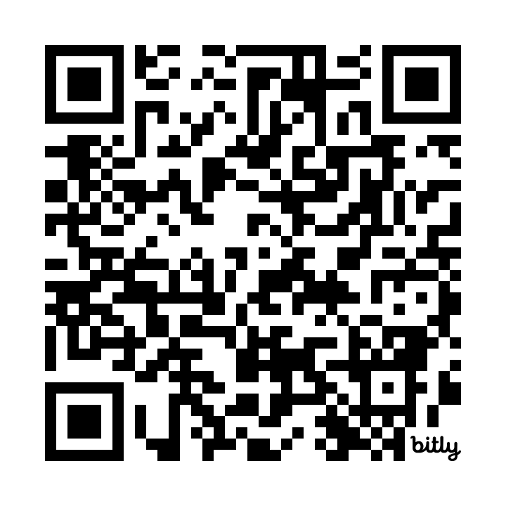
PICTURES: Some of our Activities
Over the last 3 years CIVIC +264 has held various information-sharing and networking sessions in the Omaheke, Otjozondjupa, Erongo, Hardap, Oshikoto, Oshana, Kunene, //Kharas, Khomas and Kavango West regions with the support of the Hanns Seidel Foundation (HSF).

Slide 13
Chat to us!
info@civic264.org.na
+264 81 268 6786
www.civic264.org.na
Facebook, Instagram, X/Twitter, LinkedIn, YouTube: Civil Society Information Centre Namibia (CIVIC +264)
Scan to CIVIC +264 Website

